Slide 1

“Online Voting System Using Blockchain”
TERNA ENGINEERING COLLEGE
DEPARTMENT OF COPUTER ENGINEERING
BE/SEM-VII
C-23 Atharva Birje
C-28 Harsh Minde
C-44 Jyotiraditya Patil
C-63 Ameya Mane
Under the guidance of
Prof. Dnyaneshwar Thombre
Academic Year
2024-25

Slide 2
CONTENT
Introduction
Abstract
Literature review
Problem Statement
Objective of Project
Scope of Project
Proposed System/ Architecture Diagram
H/W and S/W requirements
Expected Outcome
Motivation
Conclusion
References

Slide 3
INTRODUCTION
This project focuses on using blockchain technology to improve the security and transparency of voting systems. Existing methods face issues like fraud and lack of trust, which blockchain's decentralized ledger can mitigate. The project builds on previous work to create a verifiable and secure voting system, advancing digital democracy.

Slide 4
ABSTRACT
This project develops a blockchain-based online voting system to enhance election security and transparency. By leveraging blockchain's immutable and decentralized features, the system prevents vote tampering and ensures real-time verification, addressing traditional voting challenges. The study aims to modernize and secure the electoral process through a reliable digital platform.

Slide 5
LITERATURE SURVEY
Sr. No. | Project Title | Author | Key Findings | Limitations
1. | Blockchain Enabled Online-Voting System | Akhil Shah, Nishita Sodhia, Shruti Saha, Soumi Banerjee, Madhuri Chavan​ 2020 | Utilizes blockchain to create an immutable and transparent voting system. Incorporates 128-bit AES encryption and SHA-256 for enhanced security. Authentication through unique identification keys and biometric fingerprint verification. Votes are cast and recorded as blockchain transactions, ensuring integrity and transparency. | The system currently uses Ethereum, a public blockchain, which may face scalability issues. The paper's model is designed for small organizations and may not be directly scalable to national-level elections. The use of fingerprint authentication alone may not be sufficient for comprehensive security, which we plan to enhance by integrating additional biometric measures such as facial recognition in our project.

Slide 6
Sr. No. | Project Title | Author | Key Findings | Limitations
2. | Secure Electronic Voting System using Blockchain Technology | D. Dwijesh Kumar, D. V. Chandini, Dinesh Reddy 2020 | Voter information and vote data are stored in two separate blockchains , enhancing privacy. Votes are cast as blockchain transactions, and the system uses a two-step verification process involving a PIN. Ensures verifiability by allowing users to confirm that their vote has been correctly recorded and counted. Implements SHA-256 encryption for securing vote and voter data, guaranteeing immutability and protection against tampering. | The dual blockchain setup introduces scalability issues due to the complexity of maintaining two separate chains. The system’s reliance on voters remembering their PINs could lead to usability challenges. Although the model improves privacy, it may require further enhancements to ensure robustness at a national election scale.

Slide 7
Sr. No. | Project Title | Author | Key Findings | Limitations
3. | A Privacy-Preserving Voting Protocol on Blockchain | Wenbin Zhang, Sheng Huang, Yuan Yuan, Yanyan Hu, Shaohua Huang, Shengjiao Cao, Anuj Chopra 2018 | Introduces a decentralized voting protocol using homomorphic encryption and distributed tallying, eliminating the need for trusted third parties. Ensures privacy by encrypting votes and distributing ballots across peers. Detects and corrects dishonest votes while preserving anonymity. Leverages Hyperledger Fabric, making it feasible for small-to-medium scale elections. | The system’s complexity increases with the number of peers, potentially leading to performance bottlenecks. Homomorphic encryption adds computational overhead, which may slow down vote tallying and verification, especially in large-scale elections. The model focuses on small-to-medium-sized voting events and would require significant optimization for large-scale national elections.

Slide 8
Sr. No. | Project Title | Author | Key Findings | Limitations
4. | A Scalable Implementation of Anonymous Voting over Ethereum Blockchain | Jae-Geun Song, Sung-Jun Moon, Ju-Wook Jang 2021 | The system allows for scalability in terms of both the number of voters and candidates, surpassing the limitations of previous blockchain voting systems. Time complexity is reduced. | The scalability of the solution, while improved, still faces challenges when applied to "big voting" scenarios, such as national elections. The system relies on a large prime number to accommodate scalability, which could potentially lead to performance issues .

Slide 9
Sr. No. | Project Title | Author | Key Findings | Limitations
5. | Implementation of Decentralized Blockchain E-voting | Saad Moin Khan, Aansa Arshad, Gazala Mushtaq, Aqeel Khalique, Tarek Husein 2018 | Decentralized Security: Blockchain ensures a tamper-proof and transparent voting process. Smart Contracts: Automates and secures the voting process. Voter Trust: Real-time vote verification enhances transparency. User Interface: Metamask provides easy voter interaction with the system. | These are the limitations of this paper, and we are addressing them in our project: scalability issues, reliance on internet connectivity, complex setup, and the need for Ether. We are optimizing the system, adding offline options, simplifying the setup, and exploring alternatives to cryptocurrency.

Slide 10
Sr. No. | Project Title | Author | Key Findings | Limitations
6. | Decentralized Voting Platform Based on Ethereum Blockchain | David Khoury, Elie F. Kfoury, Ali Kassem, Hamza Harb 2020 | Smart contracts ensure transparency and enforce voting rules, allowing one vote per registered mobile number . Voter authentication is achieved without a third-party server, enhancing privacy and security . | The system may face challenges with scalability when deployed on a national level. Additionally, the requirement for users to have Ether for transactions may be a barrier.

Slide 11
Sr. No. | Project Title | Author | Key Findings | Limitations
7. | E-Voting System in Smart Phone Using Mobile Application | G. Kalaiyarasi, T. Narmadha, K. Balaji, V. Naveen 2020 | Developed an Android-based e-voting system using AES256 encryption for secure vote storage and Firebase for OTP generation. The system allows voters to cast votes remotely, minimizing fraud and human errors in manual vote counting. Results are published instantly after the election ends. | No offline voting support, limiting access for users in remote areas. Reliance on OTP for authentication, vulnerable to mobile number or network issues. Potential security concerns with Firebase, as third-party servers may introduce vulnerabilities.

Slide 12
Sr. No. | Project Title | Author | Key Findings | Limitations
8. | Performance Analysis and Application of Mobile Blockchain | Kongrath Suankaewmanee, Dinh Thai Hoang, Dusit Niyato, Suttinee Sawadsitang, Ping Wang, Zhu Han 2018 | Introduced "MobiChain," a blockchain-based application for securing transactions in mobile commerce. Developed mobile-friendly mining processes that can be executed on mobile devices, improving security and transparency in m-commerce. Performance analysis showed efficiency in terms of memory, computation time, and energy consumption. | Computational power and energy constraints on mobile devices limit mining efficiency. Scalability challenges when handling large volumes of transactions. Delays may occur during the mining process on mobile devices.

Slide 13
Sr. No. | Project Title | Author | Key Findings | Limitations
9. | A Usable Android Application Implementing Distributed Cryptography for Election Authorities | Stephan Neumann, Oksana Kulyk, Melanie Volkamer 2014 | Developed an Android app for secure distributed key generation and verifiable vote decryption. Designed for non-technical election authorities to use easily without deep technical knowledge. Includes educational material, but users struggled with complex security concepts, highlighting the need for better educational tools. | Users' incomplete understanding of cryptography. Trust in external components like the web bulletin board poses risks. Usability testing was limited, requiring broader evaluation.

Slide 14
Sr. No. | Project Title | Author | Key Findings | Limitations
10. | Efficient E-voting Android Based System | Dr. Aree Ali Mohammed , Ramyar Abdolrahman Timour | Voting Methods: The system supports both SMS-based and internet-based voting, providing flexibility to voters . Authentication: Voters are authenticated through voter IDs, and GPS tracking helps identify the location of voters during the process. Security Features: Face recognition for admin access, as well as a MySQL database that prevents multiple voting from the same voter. Database Integration: Both SMS and internet voting methods are connected to the same MySQL database, ensuring consistency and preventing duplicate votes. | Security Concerns: The system admits that it is not as secure as traditional paper-ballot systems. Issues like electronic failures and system vulnerabilities in SMS voting are highlighted . Face Recognition Challenges: The face recognition system for admin access can fail under specific lighting or environmental conditions, limiting its reliability.

Slide 15
Sr. No. | Project Title | Author | Key Findings | Limitations
11. | Development of an Efficient and Secured E-Voting Mobile Application Using Android​ | Anli Sherine , Geno Peter , Albert Alexander Stonier , Desmond Wong Leh Ping , K. Praghash , Vivekananda Ganji . | Three-Step Security: The e-voting system employs a three-step security process, which includes OTP verification, email verification, and fingerprint authentication, significantly increasing security against phishing and unauthorized access . Testing in University: The system was tested within a university setting in Malaysia for student elections, demonstrating high user satisfaction and security performance. | Complex Verification Process: The multi-step verification process, while secure, may be cumbersome for users, especially in areas with poor internet connectivity, as it relies on OTP, email, and fingerprint verification . Dependency on Modern Devices: The system’s reliance on fingerprint authentication means it may not be suitable for users with older devices that lack fingerprint scanning technology.

Slide 16
Sr. No. | Project Title | Author | Key Findings | Limitations
12. | Survey on Blockchain-Based Data Storage Security for Android Mobile Applications | Hussam Saeed Musa, Moez Krichen, Adem Alpaslan Altun, Meryem Ammi | Blockchain enhances security and reliability of mobile app data storage. BSADS framework consists of six comprehensive layers. Identified challenges include scalability, performance, and cost. Proposed solutions include blockchain pruning and energy-efficient consensus algorithms. Emphasized importance of lightweight nodes for mobile apps. Highlighted research gaps in energy efficiency and usability. Blockchain offers advantages over traditional encryption methods. | Unsuccessful implementations in mobile voting projects. Scalability issues in Ethereum Name Service (ENS). DAO hack highlighting blockchain security vulnerabilities. Restricted throughput causing slower transaction times. High costs of data storage on blockchain. Privacy concerns due to blockchain transparency. Resource-intensive smart contracts affecting cost-effectiveness. Limited computational power impacting user experience. Different consensus algorithms affecting scalability and performance.

Slide 17
Sr. No. | Project Title | Author | Key Findings | Limitations
13. | Measurements of Mobile Blockchain Execution Impact on Smartphone Battery | Yulia Bardinova, Konstantin Zhidanov, Sergey Bezzateev, Mikhail Komarov, Aleksandr Ometov | PoW algorithms significantly increase battery discharge rates. PoA algorithms have minimal impact on battery performance. Battery temperature rises significantly with PoW usage. Cellular connections worsen battery discharge compared to Wi-Fi. Dataset provides insights for blockchain impact on smartphone batteries. | PoW algorithms negatively impact smartphone battery life. Limited computational capabilities of smartphones compared to PCs. Lack of existing measurements for resource-constrained devices. PoW execution affects user experience negatively.

Slide 18
PROBLEM STATEMENT & OBJECTIVE
PROBLEM STATEMENT :
Traditional voting methods are vulnerable to errors, tampering, even cost high, and lack transparency, leading to inefficiencies and security concerns. The growing demand for trustworthy elections highlights the need for a secure, modern solution.
OBJECTIVE:
The objective is to enhance security, increase transparency, and ensure voter privacy while improving accessibility and guaranteeing immutability. Additionally, the project aims to reduce costs, enhance trust, and facilitate real-time results.

Slide 19
SCOPE OF THE PROJECT
This system will replace traditional voting methods with a decentralized approach, significantly enhancing the integrity and trustworthiness of the electoral process. The scope of the project encompasses the development of a robust mobile application, seamlessly integrated with blockchain technology to ensure secure and transparent voting. Additionally, the project includes the integration of a secondary database to support data management and backup, ensuring reliability. Focus will also be placed on implementing advanced security measures and optimizing performance to safeguard the system against potential threats. Lastly, the project will address scalability to ensure the system can efficiently handle a large number of users and transactions, maintaining high performance during peak voting periods.

Slide 20
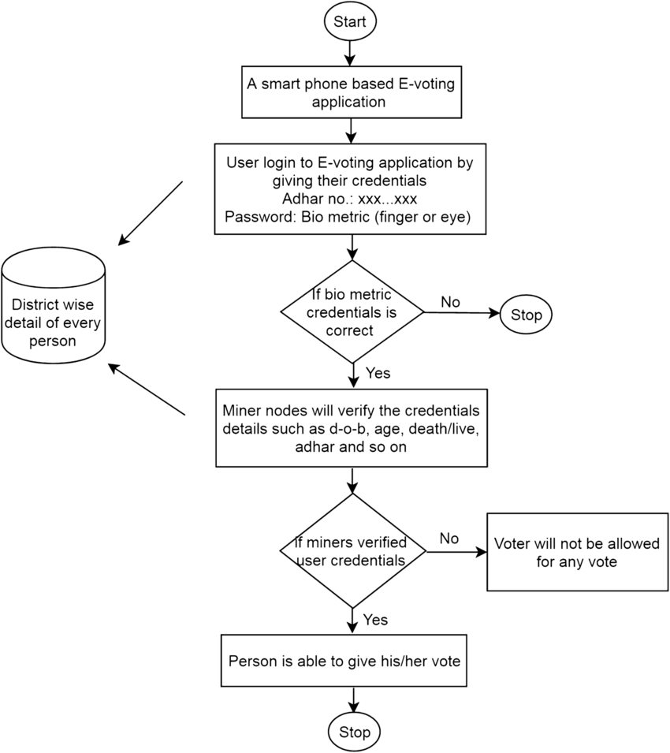
PROPOSED SYSTEM
Flow Chart :
User database

Slide 21
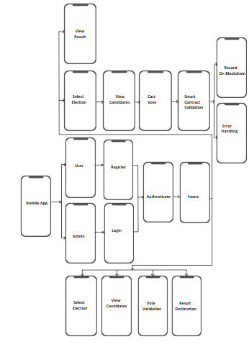
Architecture Diagram:

Slide 22
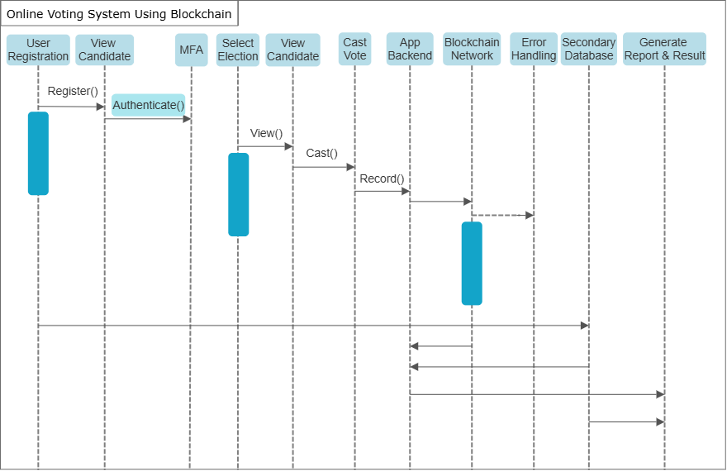
Sequence Diagram :-

Slide 23
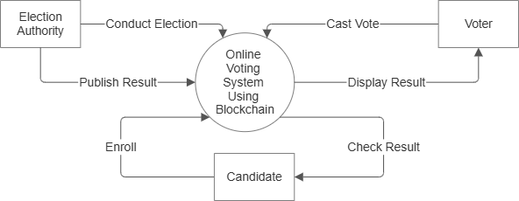
Data Flow Diagram (DFD Level 0) :-

Slide 24
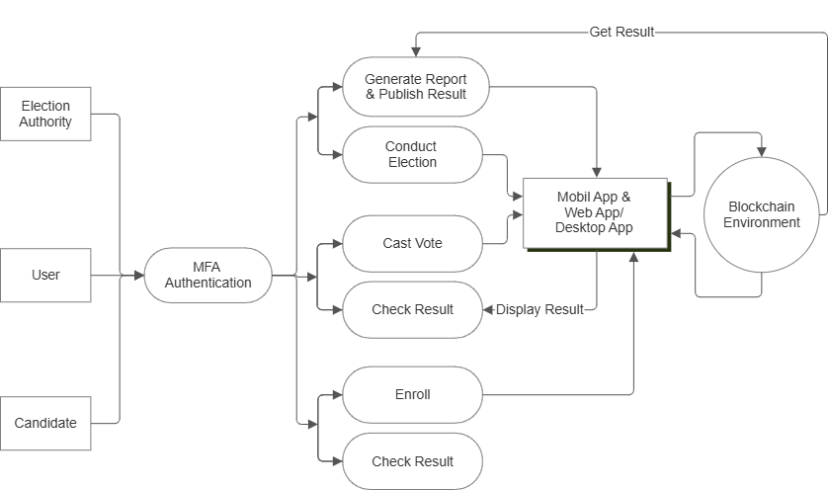
Data Flow Diagram (DFD Level 1) :-

Slide 25
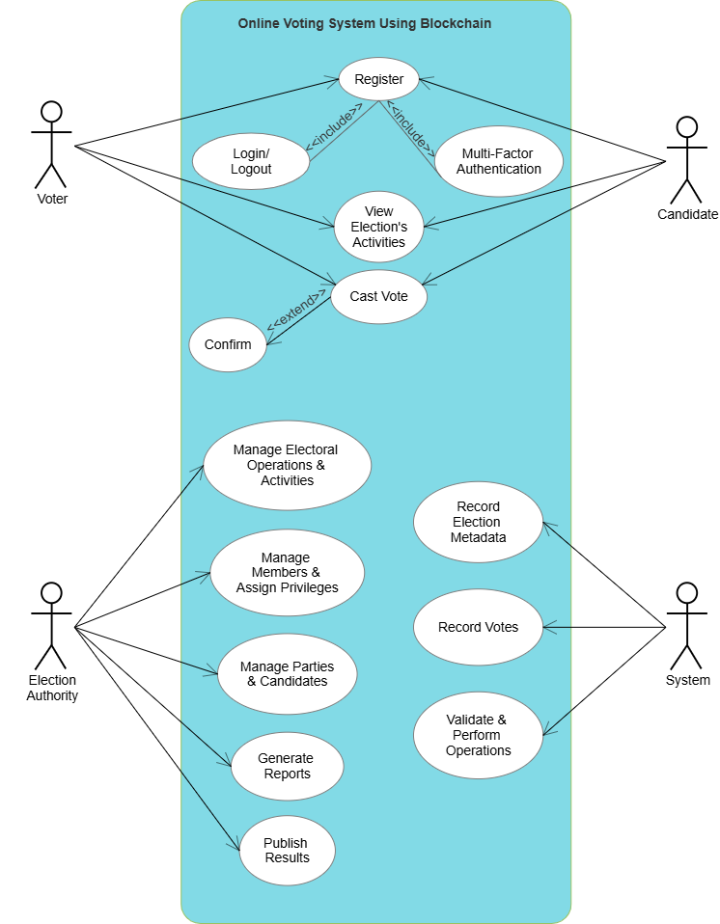
Use Case Diagram (UCD) :-

Slide 26
PROPOSED SYSTEM
Users register and log in using multi factor authentication, secured by biometric and two-factor authentication.
After successful login, they cast votes via a secure interface, with each vote recorded on the Ethereum blockchain using Solidity smart contracts to ensure uniqueness and prevent duplication.
Non-sensitive data / metadata is stored in Secondary database, while sensitive vote data is securely stored on the blockchain for transparency.
Real-time election results are fetched from the blockchain and displayed on a user-friendly interface developed in Android /Flutter.
The system ensures end-to-end encryption, voter anonymity, and is designed to handle large user loads during peak voting times.

Slide 27
HARDWARE USED
Mobile Devices:
Smartphones (iOS and Android)
Tablets (iOS and Android)
Servers:
Blockchain nodes servers
Backend servers
Cryptographic Hardware:
Hardware Security Modules (HSM)
Development and Testing Hardware:
Laptops/Desktops for developers
Test devices (various models of smartphones and tablets)
5. Security Hardware:
Biometric authentication devices (optional, for enhanced security)
Two-factor authentication (2FA) devices

Slide 28
SOFTWARE USED
1.Blockchain Network:
- Ethereum
2. Smart Contract (Development):
- Solidity
3. Mobile App Development Frameworks:
- Android
- Flutter
4. Database:
- Firebase
- MongoDB
5. Development and Testing Tools:
- Truffle
- Ganache
- Android Studio
- Remix IDE
6. API Integration:
- Web3.js
- Ethers.js

Slide 29
EXPECTED OUTCOMES
We expect that the system will allow voters to securely cast their votes via a mobile application, with immutable vote records on the blockchain to prevent tampering, ensuring a transparent election process through a public ledger accessible to all, while protecting voter identity. Additionally, real-time results will be directly calculated from the system, with scalability to handle large-scale elections, and auditability will provide election officials with access to logs to maintain election integrity.

Slide 30
MOTIVATION
Traditional voting systems face challenges like fraud, tampering, inefficiency, and high operational costs, especially for large-scale elections.
Citizens living abroad often struggle to participate in elections due to geographic barriers, limiting their democratic rights.
This project enables secure online voting, allowing citizens to vote from anywhere in the world, ensuring their right to participate in elections is preserved.
By leveraging blockchain’s decentralized and transparent nature, this system ensures secure and accessible voting, enhancing trust in the electoral process.
The goal is to modernize the voting process, making it accessible, secure, and efficient for all, including overseas voters.

Slide 31
CONCLUSION
The Blockchain-Based Online Voting System provides a secure, scalable, and transparent platform for conducting elections.
By leveraging blockchain, the system ensures tamper-proof voting, real-time result aggregation, and verifiability.
The integration of multi-factor authentication, encryption, and a secondary database optimizes performance and security for large-scale elections.
This project represents a significant step towards modernizing the electoral process, minimizing costs, and ensuring voter trust in the system.

Slide 32
REFERENCE
Research Papers and Articles:
1.Akhil Shah, Nishita Sodhia, Shruti Saha, Soumi Banerjee, Madhuri Chavan (2020). "Blockchain Enabled Online-Voting System" ITM Web of Conferences, 32, 03018.
2.Jae-Geun Song, Sung-Jun Moon, Ju-Wook Jang (2021). "A Scalable Implementation of Anonymous Voting over Ethereum Blockchain" IEEE Access, 9, 37930-37942.
3.Saad Moin Khan, Aansa Arshad, Gazala Mushtaq, Aqeel Khalique, Tarek Husein (2018). "Implementation of Decentralized Blockchain E-voting" International Journal of Computer Applications, 182(20), 1-5.
4.David Khoury, Elie F. Kfoury, Ali Kassem, Hamza Harb (2020). "Decentralized Voting Platform Based on Ethereum Blockchain" 2020 International Conference on Decentralized Applications and Infrastructures (DAPPS), 65-70.

Slide 33
REFERENCE
Research Papers and Articles:
5.Wenbin Zhang, Sheng Huang, Yuan Yuan, Yanyan Hu, Shaohua Huang, Shengjiao Cao, Anuj Chopra (2018). "A Privacy-Preserving Voting Protocol on Blockchain" Journal of Information Security, 9(1), 54-67.
6.D. Dwijesh Kumar, D. V. Chandini, Dinesh Reddy (2020). "Secure Electronic Voting System using Blockchain Technology" Proceedings of the 2020 Blockchain Conference, 112-119.
7.G. Kalaiyarasi, T. Narmadha, K. Balaji, V. Naveen (2020). "E-Voting System in Smart Phone Using Mobile Application" International Journal of Advanced Research in Computer Science, 11(4), 41-48.
8.Stephan Neumann, Oksana Kulyk, Melanie Volkamer (2014). "A Usable Android Application Implementing Distributed Cryptography for Election Authorities" Journal of Cryptography, 7(2), 120-130.

Slide 34
REFERENCE
Research Papers and Articles:
9.Dr. Aree Ali Mohammed, Ramyar Abdolrahman Timour (2020). "Efficient E-voting Android Based System" International Journal of Advanced Computer Science and Applications, 11(5), 75-81.
10.Hussam Saeed Musa, Moez Krichen, Adem Alpaslan Altun, Meryem Ammi (2019). "Survey on Blockchain-Based Data Storage Security for Android Mobile Applications" Journal of Blockchain Research, 5(3), 102-110.
11.Yulia Bardinova, Konstantin Zhidanov, Sergey Bezzateev, Mikhail Komarov, Aleksandr Ometov (2019). "Measurements of Mobile Blockchain Execution Impact on Smartphone Battery" Journal of Mobile Computing, 8(1), 58-67.

Slide 35
THANK YOU !!

